Slide 1
Bank App Enhancement
By: Joshua Okossi, Phillip Nissen, Alexander Rodriguez, Loi Ngo Duc Nguyen

Slide 2

Scenario
The intersection of social and finance—as well as shifting attitudes around what we share about money online—have given way to an ambitious new wave of financial products.
Our team has prepared an analysis for a client about a potential new product in social finance area.
Research the current products on the market and make a case for a new app (product) for an underserved market.
Our analysis includes strategy, innovation as well as disruption in the target market.
The client we decided to pitch this analysis and product to is a bank
Notes:
Joshua

Slide 3
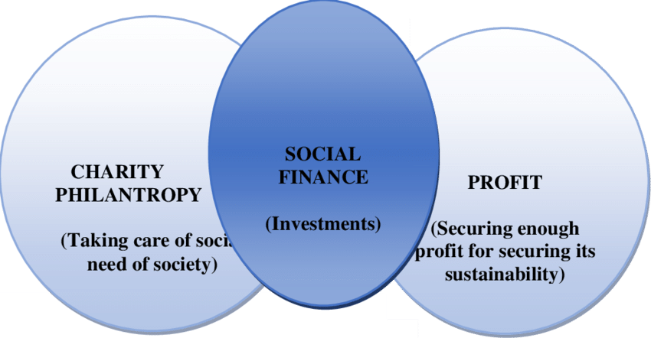
What is Social Finance
Definition- “a category of financial services which aims to leverage private capital to address challenges in areas of social and environmental need”
Use of financial resources for positive impact
Notes:
Alex

Slide 4
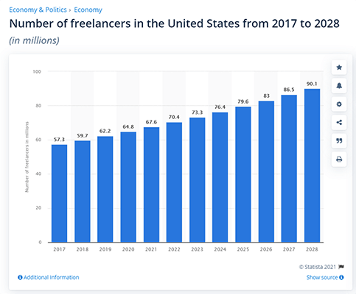
The Social Finance Market: freelancers
70.4 million freelancers in the U.S., as of 2022
56% of freelancers had used a loan or line of credit to manage their finances.
58% of freelancers have had to dip into their personal savings to make ends meet, while 46% have turned to credit cards for financial support.
Notes:
Loi

Slide 5

Existing Products
Kasisto:
Pros
Designed specifically for banking and financial services, with a focus on providing personalized and intuitive customer service.
Offers advanced natural language processing (NLP) capabilities, enabling the chatbot to understand and respond to complex customer inquiries.
Can be integrated with existing banking systems and platforms.
Cons:
Implementation and customization may require significant resources and expertise.
Not having the ability to help customers manage their finance.
Notes:
Loi

Slide 6

Existing Products
Lemonade (for insurances company)
Pros:
Offers a unique and modern approach to insurance, with a focus on transparency and customer engagement.
Uses AI and chatbots to provide fast and efficient service, reducing the need for traditional customer support channels.
Can be accessed through a variety of platforms, including mobile and web.
Cons:
Limited availability, as Lemonade currently only operates in certain regions and markets.
Not having the ability to help customers manage their finance.
Notes:
Loi

Slide 7

Problem
It is very difficult for freelancers to get loans, since they may not have an employer
Underwriting a freelancer’s loan usually has to be done manually by an accountant
Existing products don’t help with this problem
Lack of personal finance education
Mismanagement of current finances
Notes:
Joshua

Slide 8

Our Solution
An easy way for freelancers to get loans and manage their finances
Leveraging a state-of-the-art Artificial Intelligence chatbot
Additional feature to help freelancers keep track of finances
Notes:
Phillip

Slide 9


Enhanced A.I Chatbot
The chatbot can be given your bank policies on loans, and relevant laws
Trained on customer service transcripts
Every time the AI can’t solve a problem, it will learn, and next time will hopefully be able to solve the problem
This will reduce (but not eliminate) the need for humans
Notes:
Phillip

Slide 10
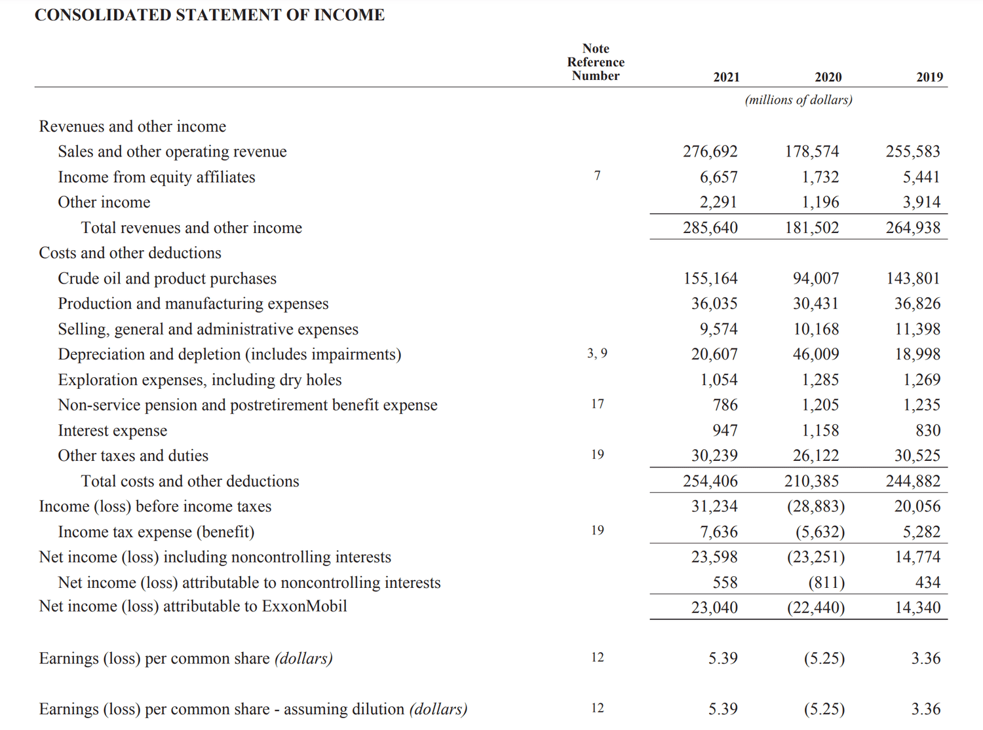
Business Financial Summary Page
The Premium Version provides a one-stop shop for freelancers to keep track of their finances
Can be filled in either manually by the user, or based on data they tell the chatbot
This feature is included for Premium users, which you can charge a service fee to use
Notes:
Phillip

Slide 11
Strategy to Implement
Advertisement will be done for active members within bank who can take advantage of feature
Banks will educate freelance customer base on new feature
Provided will be short demonstational videos on how to use different areas of the feature
Our team will have customer service system for bank issues as well as a department for their clients
Banks can then determine individual service fees for premium features
Notes:
Alex

Slide 12
How these Feature are Innovative
Feature is integrated into the banking application allowing quick access to all financial information
Loans can be approved by bank within the feature, convenient on both ends
AI assistant provides modern feature to freelance market
Since AI learns through customer interaction, user experience will improve over time
How this disrupts the market
Allows manual underwriting for freelancers without hiring an outside party
Notes:
Alex

Slide 13
Conclusion
Social finance is a halfway point between for-profit and nonprofit
The freelancer market has grown significantly in recent years
Freelancers can have a hard time getting approved for loans
We are suggesting an AI chatbot which will help freelancers get approved for loans
Since it already has freelancer’s financial information, it can also show a financial summary
Notes:
Joshua

Slide 14
Works Cited
Conversational AI for Banking &amp; Finance. Kasisto. (n.d.). Retrieved April 25, 2023, from https://kasisto.com/
PYMNTS.com. (2023, February 23). Lemonade CEO says Insurance Platform 'built for AI since day one'. Lemonade CEO: Insurance Platform 'Built for AI' | PYMNTS.com. Retrieved April 25, 2023, from https://www.pymnts.com/earnings/2023/lemonade-ceo-says-insurance-platform-built-for-ai-since-day-one/
Ruby, D., &amp; About The Author Daniel Ruby Content writer with 10+ years of experience. I write across a range of subjects. (2023, April 3). 58+ freelance statistics 2023: (infographics and trends). Demand Sage. Retrieved April 25, 2023, from https://www.demandsage.com/freelance-statistics/#:~:text=Freelance%20Statistics%20(Top%20Picks)&amp;text=There%20are%20over%201.57%20billion,at%20a%20CAGR%20of%2015%25.

Slide 15
Q&A

